Slide 1

Workflow Workshop
By
Max maxuel.aragones@equivant.com
Ricky richard.marens@equivant.com
Notes:
Who are we? We write stuff for ShowCase

Slide 2
Requirements
Relational database and programing basic knowledge
Visual Studio 2017 || Visual Studio 2019
//visualstudio.microsoft.com/downloads/
Workflow Workshop solution
//github.com/maximoaragon/WorkflowWorkshop
.NET language knowledge (e.g. C# | VB.NET) is a plus
ShowCase data knowledge (e.g. tblCase, tblParty…) is a plus

Slide 3

Agenda
Fundamentals
ShowCase Workflow
Morning <br> @ 10:30 am
Workflow Sample
Lunch <br> @ 12:00 pm
Deployment Scenarios
ShowCase & Fundamentals
DES & Fundamentals
Hands-On Lab
Afternoon <br> @ 2:45 pm
Use Case Scenarios

Slide 4
ShowCase Workflows
“The engine to dynamically execute ordered instructions in ShowCase applications”
--max
Based on Windows Workflow Foundation .NET 4.0
Also called Activity
Stored as XAML / XML in a file or database
Executed at runtime
Notes:
Is NOT based on .NET 3.5
Not yet supported in .NET Core

Slide 5
Start
1st Activity
Condition
true
false
Some Activity
Some Other Activity

Slide 6
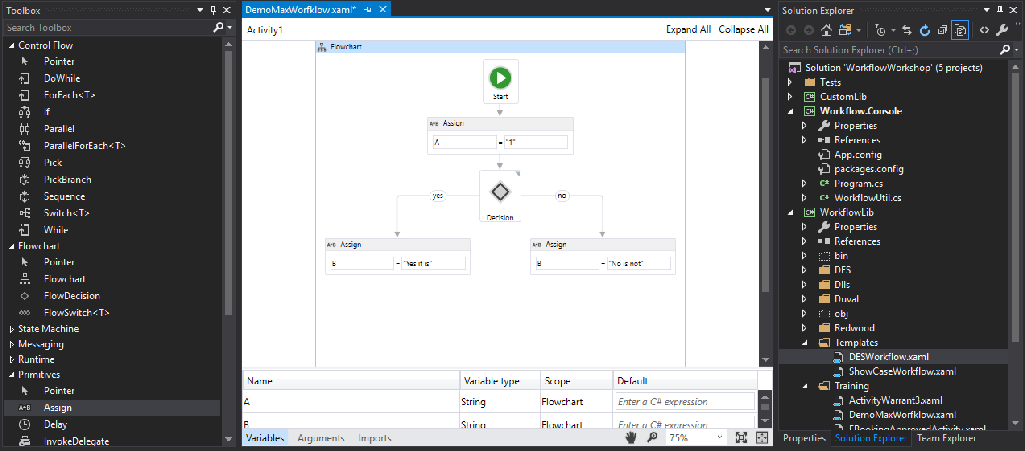
Workflow Designer (VS)
Activities
Main Designer
Workflow Files
Variables and Arguments
Notes:
Careful with expressions… they can be C# or VB.NET
TODO: Change screen

Slide 7
<br>
Notes:
morning

Slide 8
Sample Workflow
Using WorkflowWorkshop.sln add a workflow
Add a workflow under WorkflowLib\Training directory named DemoYourNameWorkflow.xaml
e.g. DemoRickyWorkflow.xaml
Add an Assign activity and initialize the Result argument
Add a new variable named developerName
Add an InvokeMethod activity and call the LoadXml method passing a xml as a string

Slide 9
Sample Workflow
Run the workflow locally
Open Program.cs
Set workflowFilePath to the path of your workflow
Add optional parameters
Run Workflow.Console to execute the workflow

Slide 10
Upload workflow to DESBoard
https://showcase.equivant.com/desboard
user: ****
pwd: ****
https://showcase.equivant.com/eps/ExchangePointService.svc/demo/{yourname}/{argument}

Slide 11
<br>
Notes:
afternoon

Slide 12
Deploying Workflows
 | Initiated By | Data Context | Identity
ShowCase | Smart Docket or Workflow Trigger (new) | Case | ShowCase User
DES | Web request | Exchange Request | ShowCase User or Anonymous

Slide 13
ShowCase Data
Case Data
Lookup Data
Case
Parties
Global
PartyType
Charges
Statutes
Dockets
DocketCodes
CourtEvents
CourtType
Notes:
Case data changes every time the case is changed.
Lookup data is cached
DAOs are under Global too

Slide 14
ShowCase Classes
CourtCollectionBase
Clear()
Add()
GetByID()
CourtSingleBase
Save()
Delete()
CPartys
CreateParty() GetMainParty()
CParty
DOB PartyType()

Slide 15

ShowCase Core Services
Authentication Service
ShowCase Client
first
Cache Service
ShowCase
DB
…

Slide 16
Code Example
Notes:
Show read-only code example that hits the database

Slide 17
Workflow Translation
Notes:
Default code-example in workflow
Future Court Events example
Return parties over 18

Slide 18
Gotchas!
Too much complexity in the workflow
Minor syntax limitations; i.e. Linq expression, async / await, using
Unattended execution - error handling; i.e., how to properly catch, communicate, redirect errors, process failures, etc.
Reinventing the Wheel; i.e., there may already exist a method, a business rule, and/or a workflow that performs the desired action(s)… or a subset of them

Slide 19
Use Case Scenarios

